Slide 1

RUNGTA COLLEGE OF DENTAL SCIENCES & RESEARCH
FIRST DENTAL VISIT
DEPARTMENT OF PEDODONTICS AND PREVENTIVE DENTISTRY

Slide 2
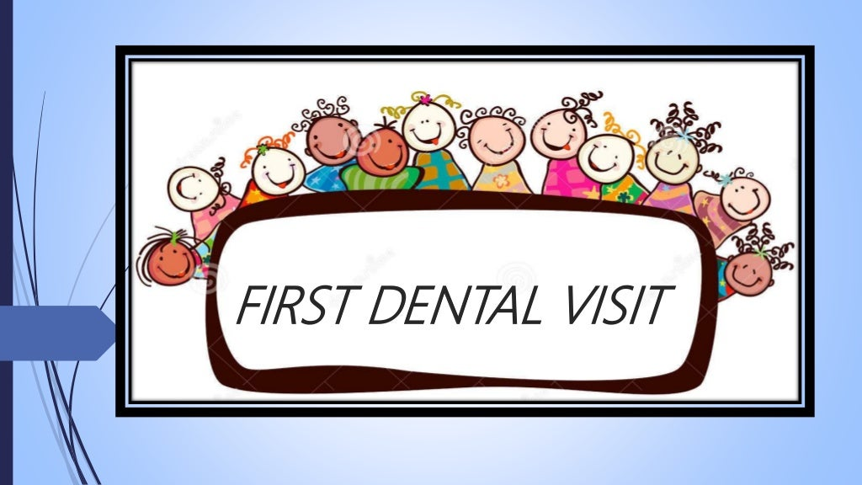

Slide 3
Specific learning Objectives
Core areas | Domain
Parents role in preparation of child for first dental visit. Pre appointment behavior modification . Pre appointment mailing . Pre appointment modelling. | Recommended procedure to be carried out on first visit. Examination of infant and toddler. Tips to prepare the child for the first dental visit.

Slide 4
CATEGORY
MUST TO KNOW
NICE TO KNOW
pre appointment behavior modification include pre appointment mailing and modelling.
DESIRE TO KNOW
Simple procedure like examination, oral prophylaxis and topical fluoride application should be carried out in first dental visit.
first visit of the child occur with in 6 month the eruption of the primary teeth.
W

Slide 5
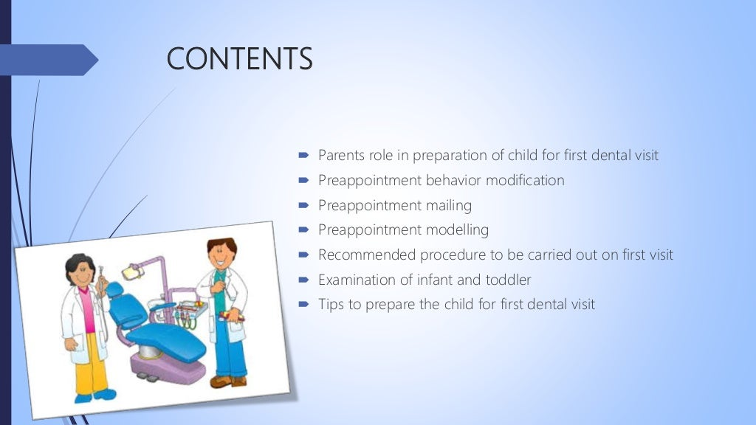

Slide 6
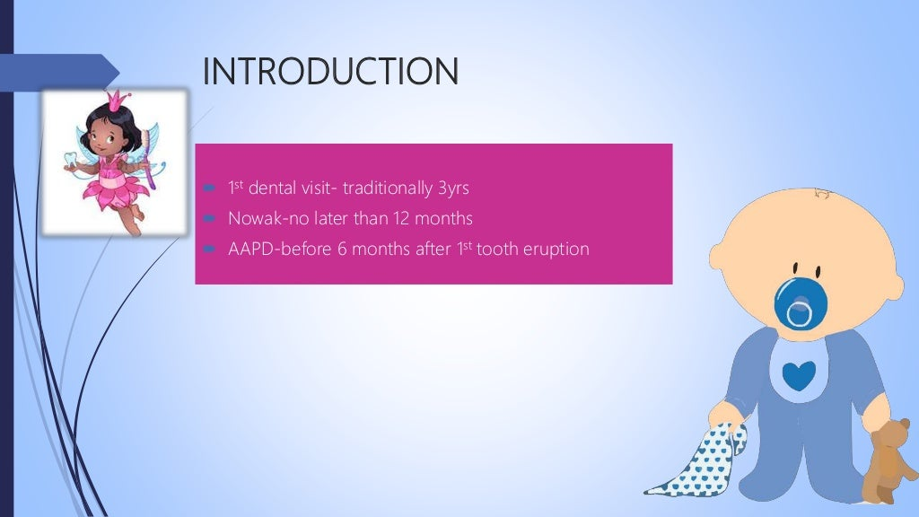

Slide 7
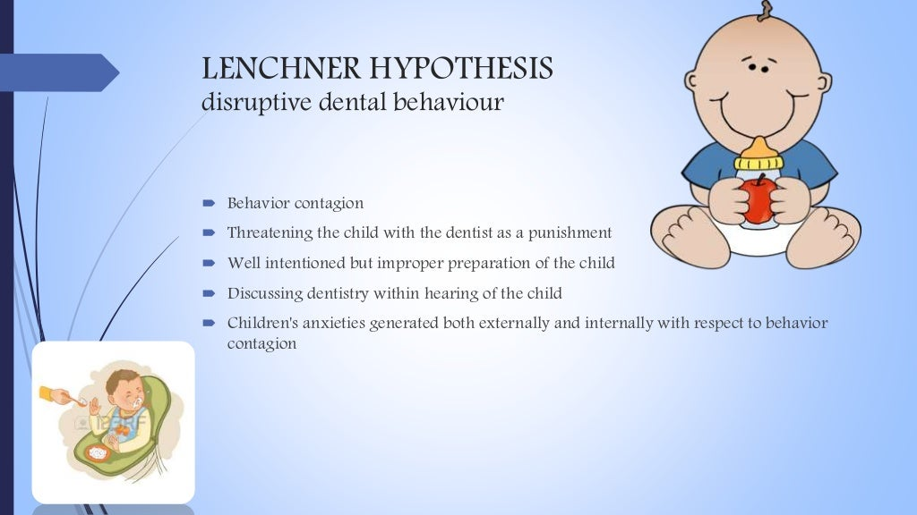

Slide 8
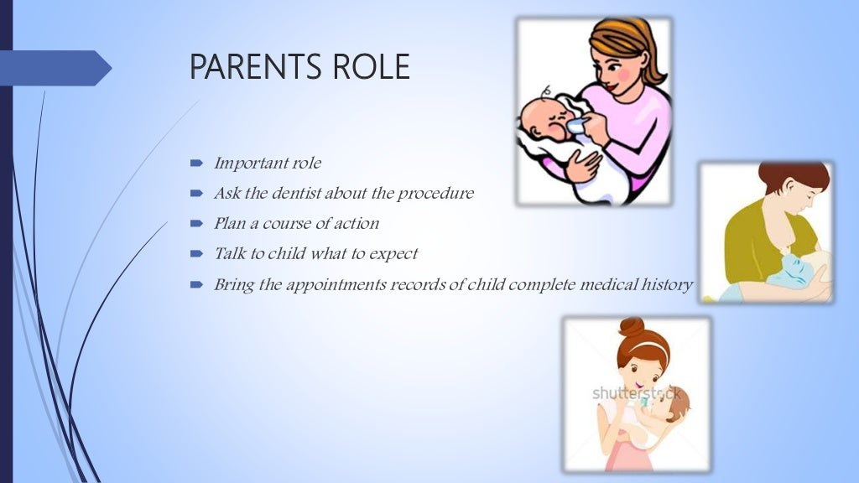

Slide 9
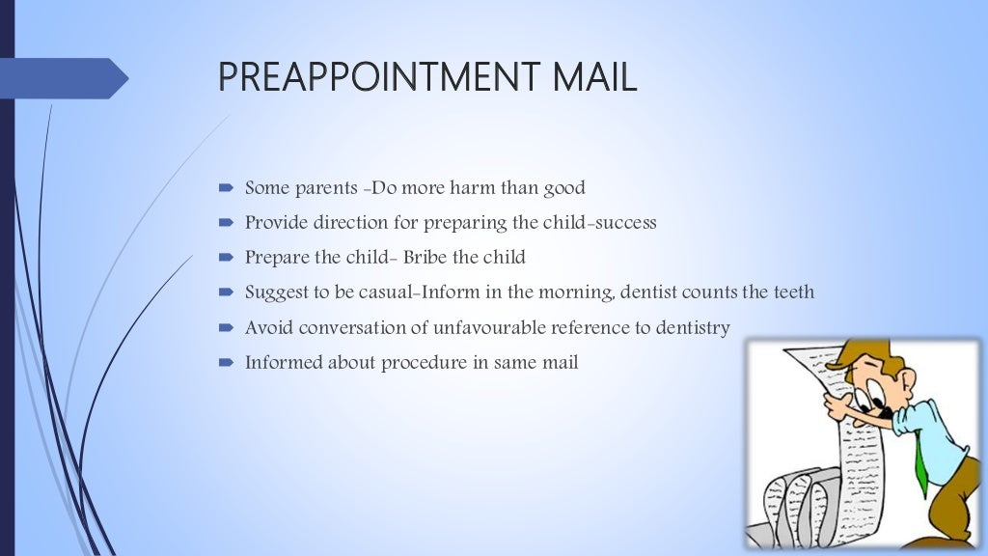

Slide 10
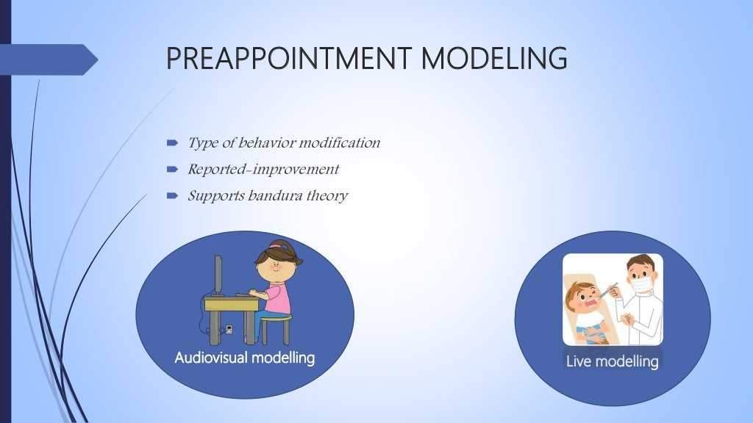

Slide 11
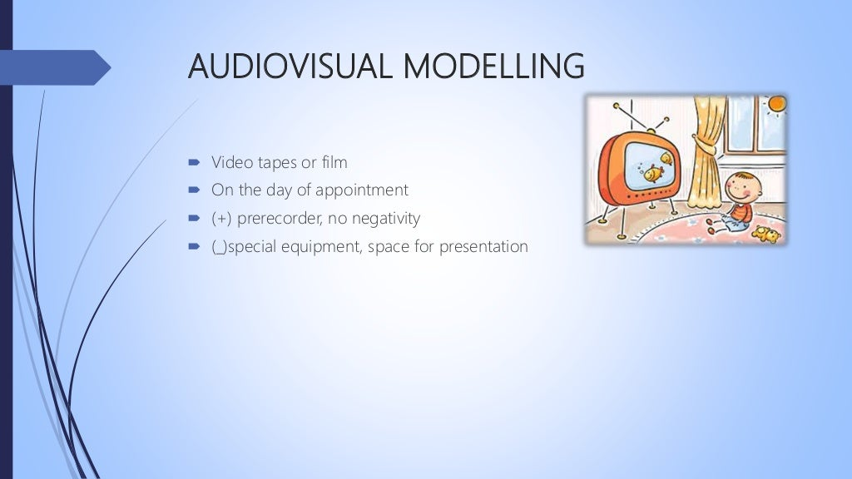

Slide 12
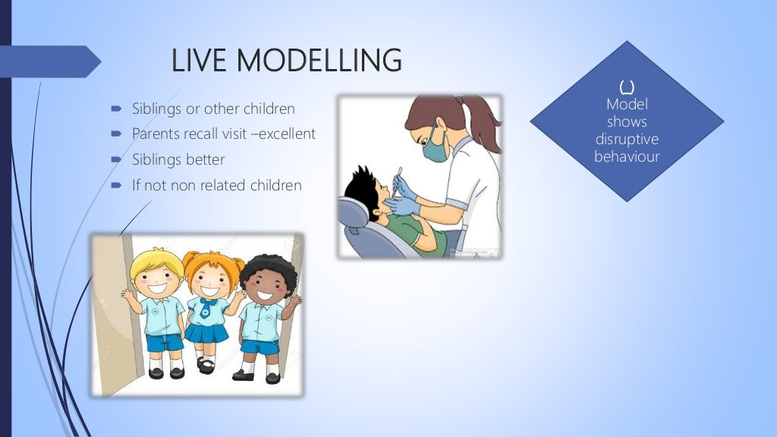

Slide 13
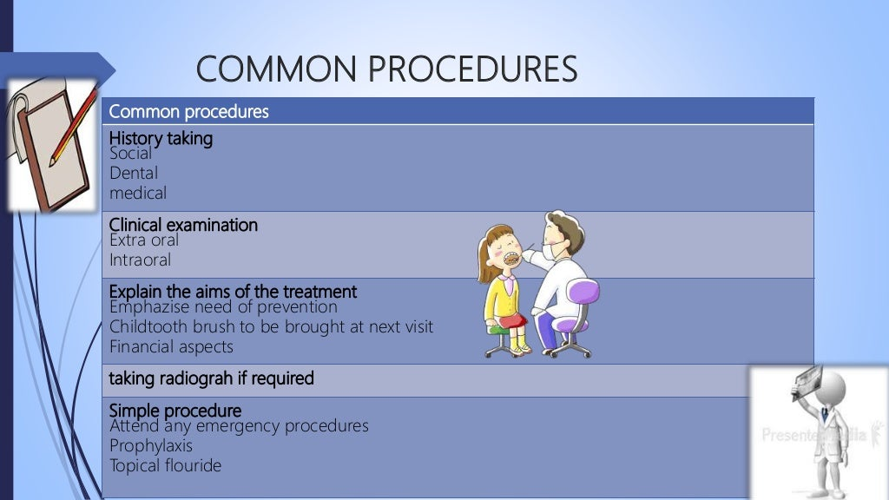

Slide 14
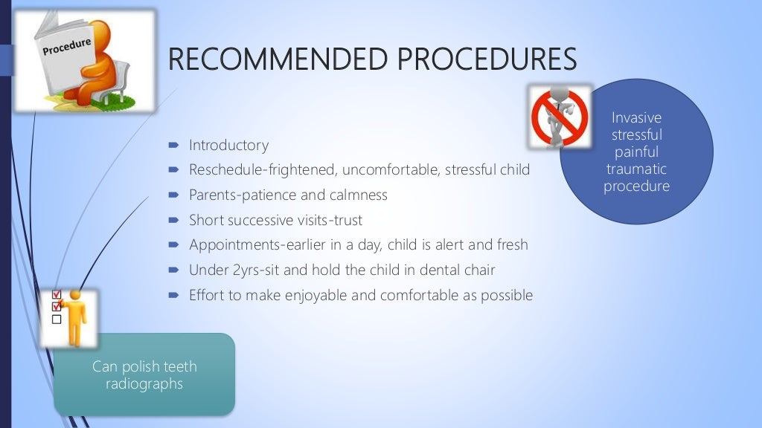

Slide 15
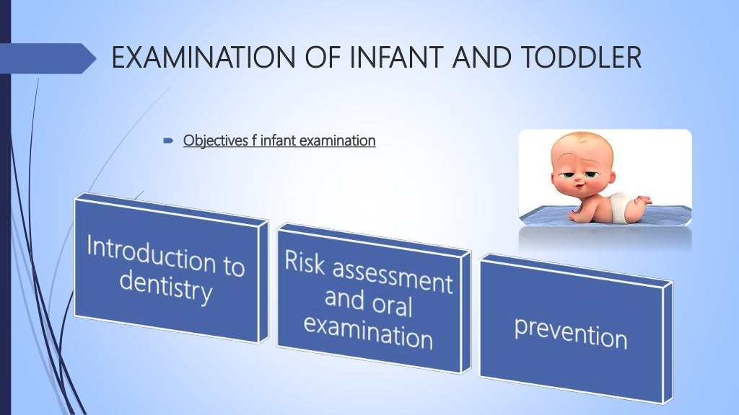

Slide 16
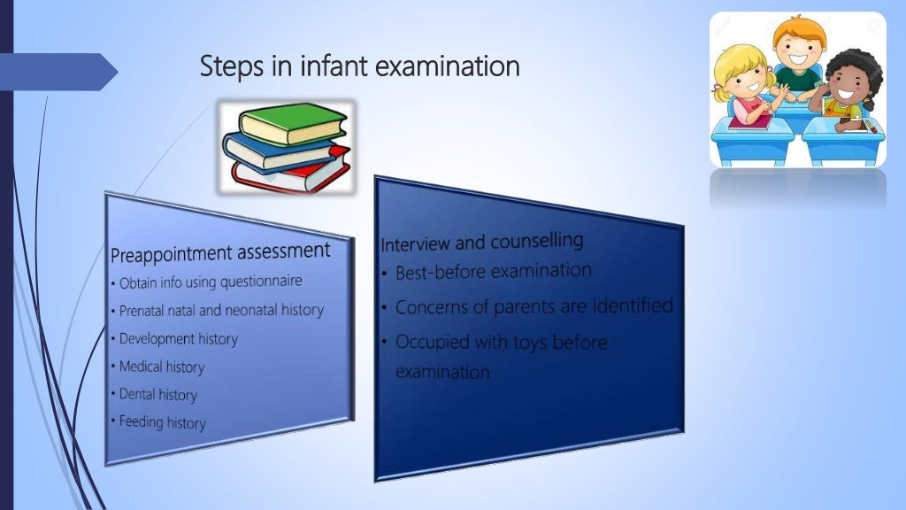

Slide 17
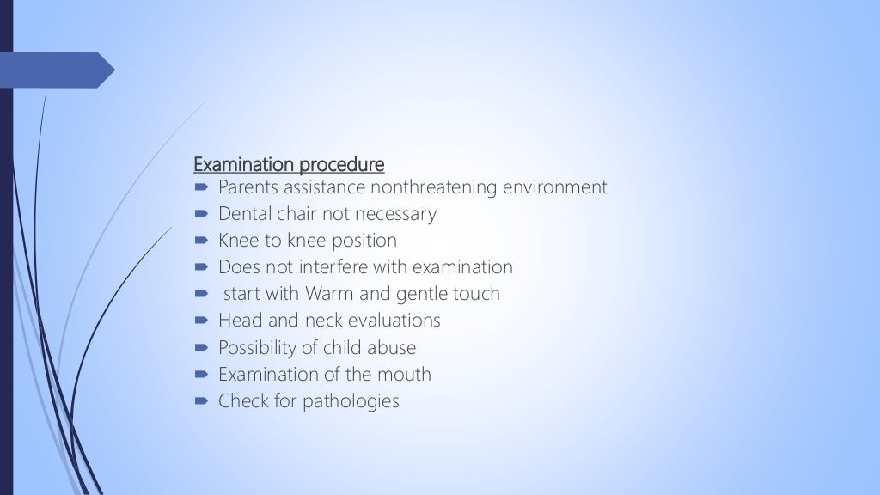

Slide 18
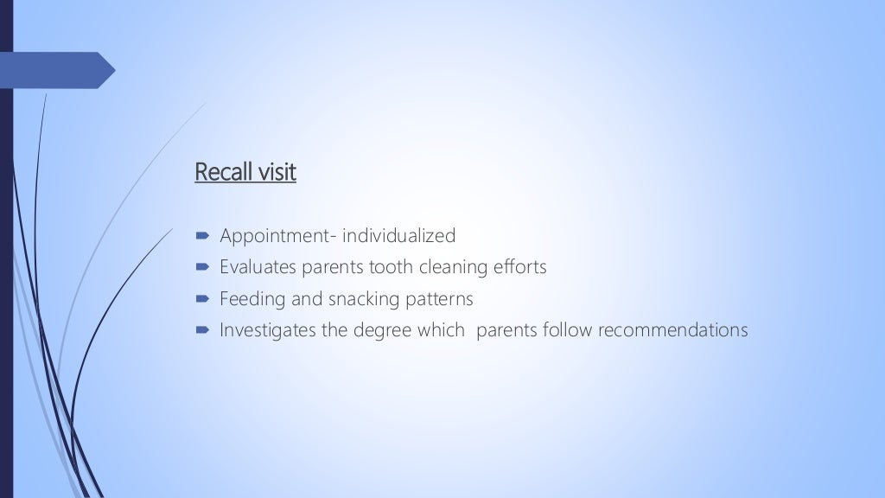

Slide 19
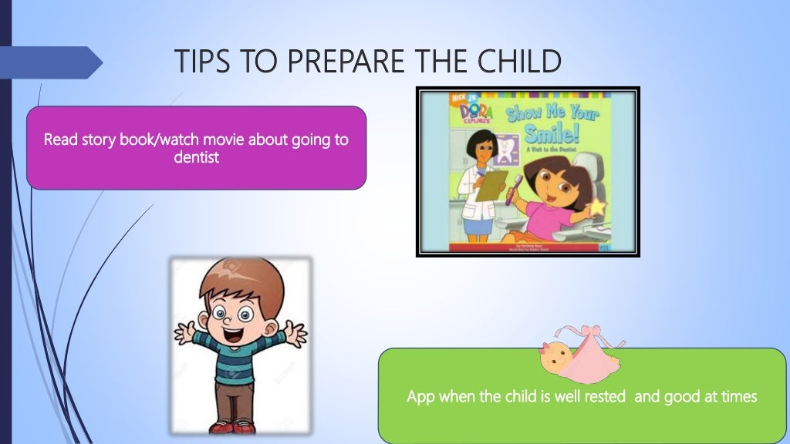

Slide 20
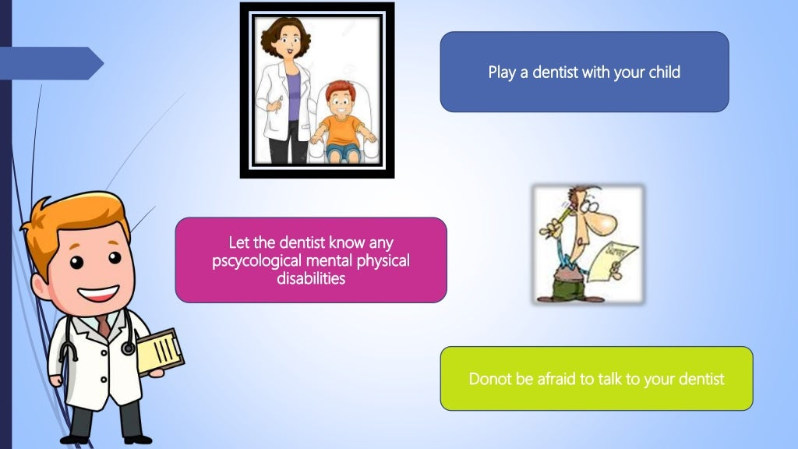

Slide 21
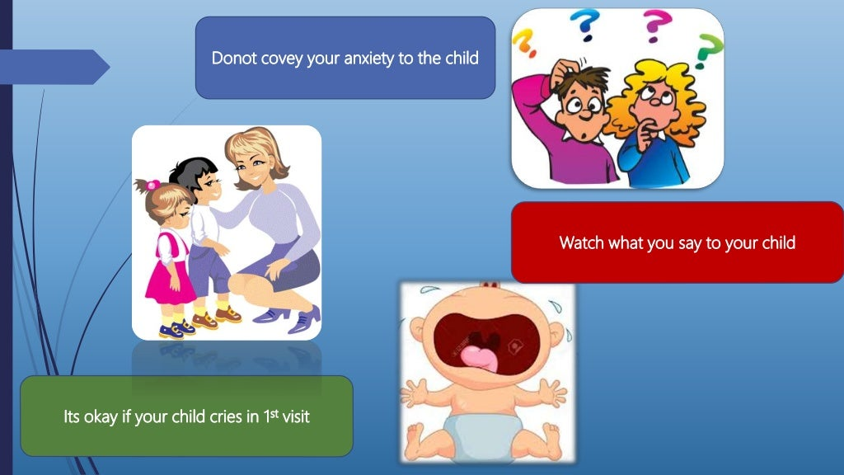

Slide 22
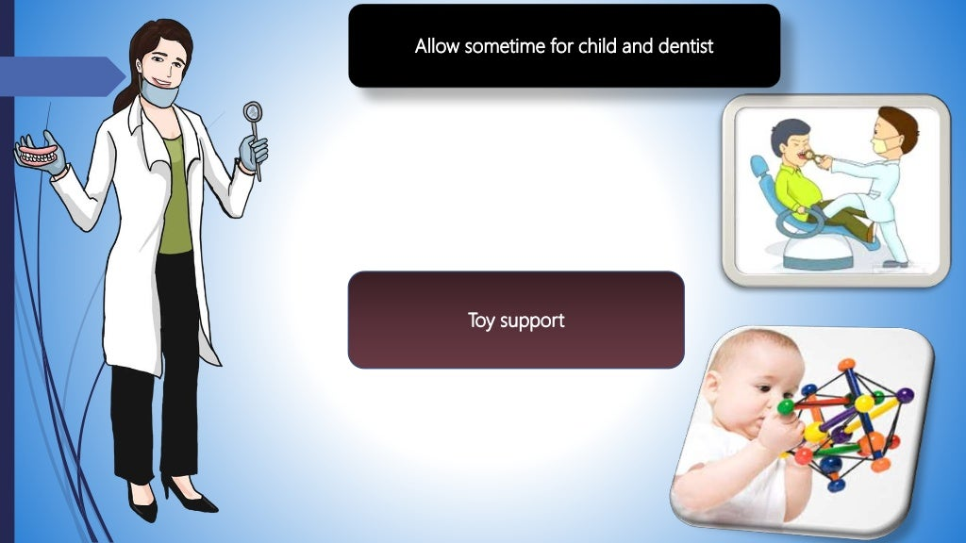

Slide 23
TAKE HOME MESSEGE
Parents role in preparation in first dental visit.
Live modeling by sibling is the best method to enhance positive behavior in a child.
Simple procedure like examination oral prophylaxis and topical fluoride application
should be carried out in first dental visit.

Slide 24


